Slide 1


CMR TECHNICAL CAMPUS
UGC AUTONOMOUS
Accredited by NBA & NAAC with ‘A’ Grade Approved by AICTE, New Delhi and JNTU, Hyderabad Kandlakoya(V), Medchal Road, Hyderabad-501401, Telangana Department of Computer Science and Engineering
A Mini Project on
AN ENHANCED MULTI-MODAL BIOMETRIC AUTHENTICATION
BATCH NO : 20
Presented By:
Juveria Khanam 217R1A0527
Chinni Krishna 217R1A0537
Alisha Tabassum 217R1A0503
Under the Guidance of
Dr. S. Suma
(Assistant Professor)

Slide 2

CONTENTS
Abstract
Introduction
Existing system
Disadvantages of existing system
Proposed system
Architecture
Advantages of proposed system
Hardware and software requirements
Modules
UML Diagrams
Result and Discussion
Future Scope
Conclusion

Slide 3
Abstract :
In today’s digital world, security demands are intensifying due to the rise in hacking, unauthorized ATM and cellphone access, and breaches in both government and private systems.
Traditional security methods often have vulnerabilities, leading to the increased adoption of biometric recognition systems, which provide more secure and reliable identification compared to passwords.
Biometrics are harder to hack, and a multimodal biometric system, which combines multiple independent biometric traits, significantly enhances security and reduces error rates.

Slide 4

Introduction:
As digital systems expand, secure authentication is essential. Traditional methods like passwords and ID cards are vulnerable to theft and fraud.
Biometric authentication, which uses unique physiological or behavioral traits like fingerprints, facial recognition, and voiceprints, offers a more secure alternative.
Unlike unimodal systems, which rely on a single trait, multimodal systems reduce False Accept Rate (FAR), False Reject Rate (FRR), and Failure to Enroll Rate (FTE), offering more reliable protection for critical systems such as computers, ATMs, and secure facilities.

Slide 5
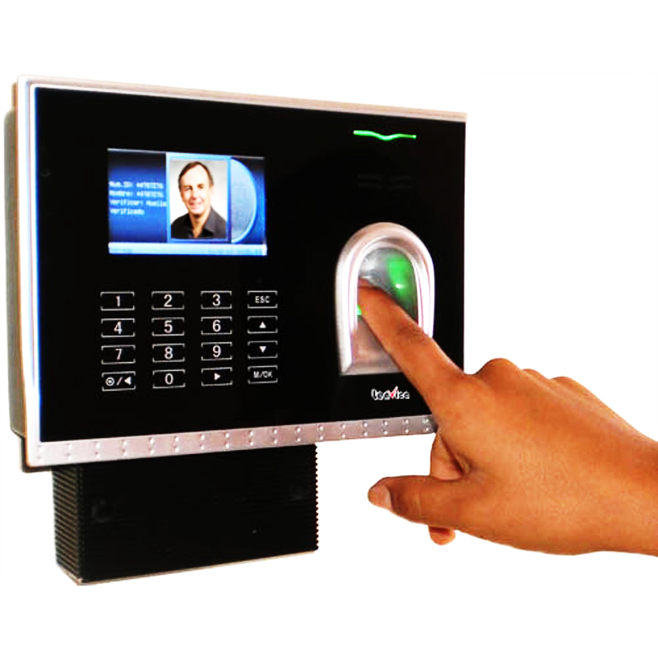
EXISTING SYSTEM
Unimodal biometric systems use a single biometric trait or characteristic for identification or verification of individuals. These systems rely on a single source of biometric data, such as a fingerprint, face recognition, or iris scan, to authenticate users.
The most common type of unimodal biometric
System is fingerprint-based, but they can be
vulnerable to spoofing attacks.

Slide 6
DisadvantageS of Existing System
Noise in the data that have been evaluated
Inter-class similarities
Intra-class variation
Spoof Attack
Non-Universality
Susceptibility to circumvention
Lack of Individuality

Slide 7
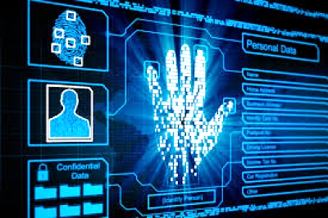
Proposed system
The proposed architecture works in a way that the biometric modality, face, and iris are captured and then fused at feature level and the result is stored in the database.
The stored result is then matched with input provided and if the match works the system is made to send OTP.
This has to be recorded as user’s voice and then compared with the voice data set which is already in the voice database.
If there is a match the system is ready for use, in any other case the access is denied.

Slide 8
Advantages of proposed system:
More Secure : hard to spoof
More accurate
Reduce False Accept Rate (FAR)
Reduce False Reject Rate (FRR)
Reduce Failure to Enrol Rate (FTE)

Slide 9
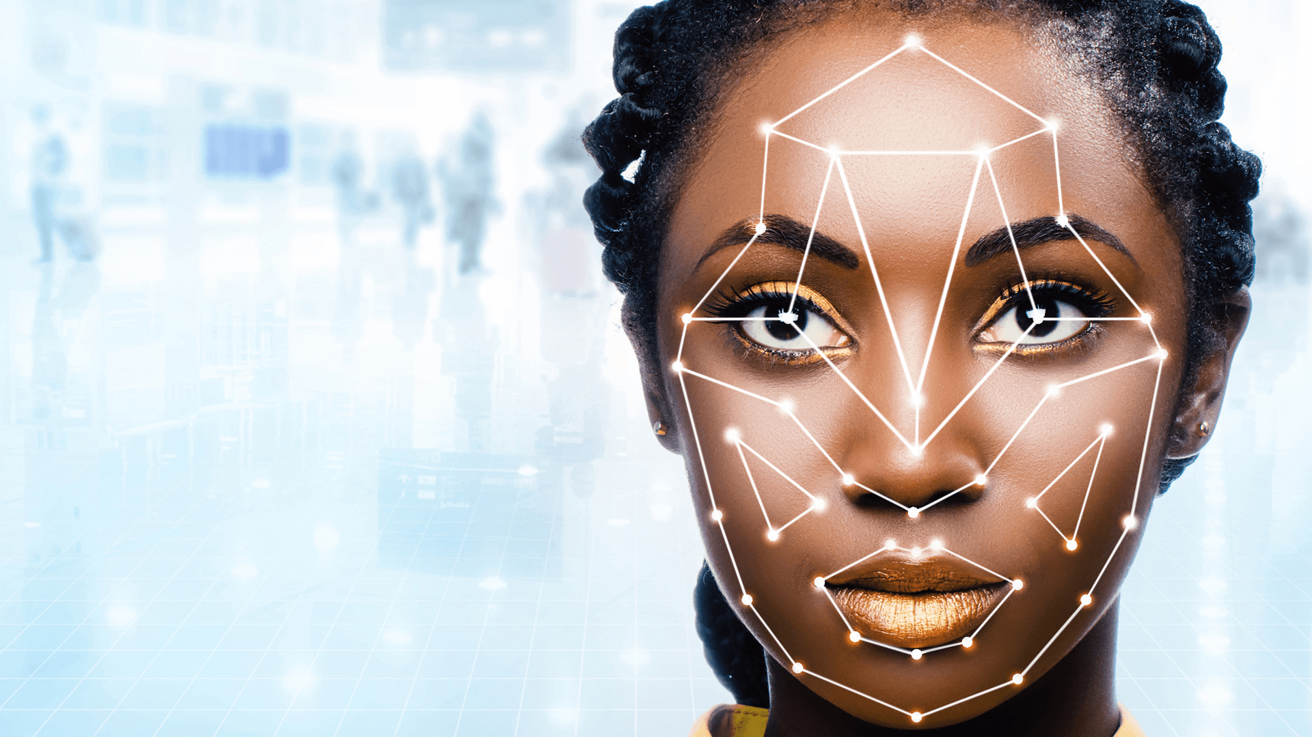
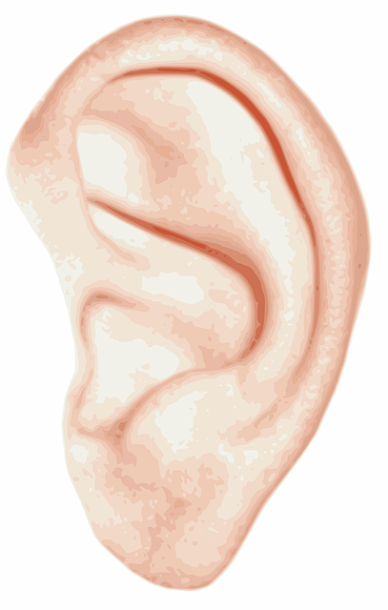
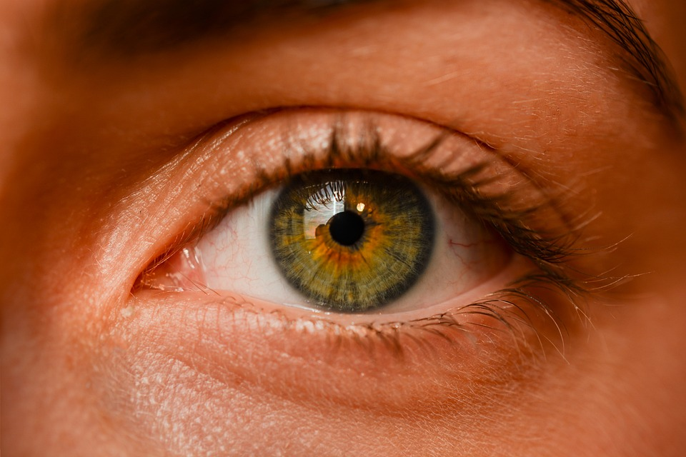
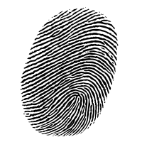
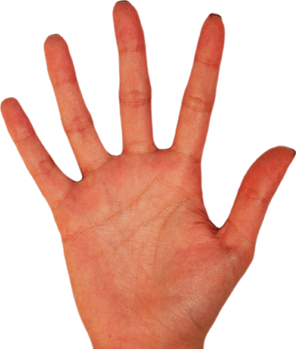
Various Features like
Multi-modal Biometric Features

Slide 10
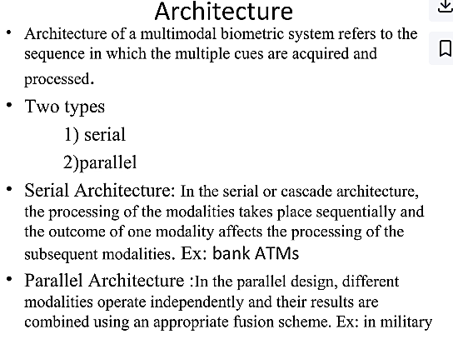






Slide 11
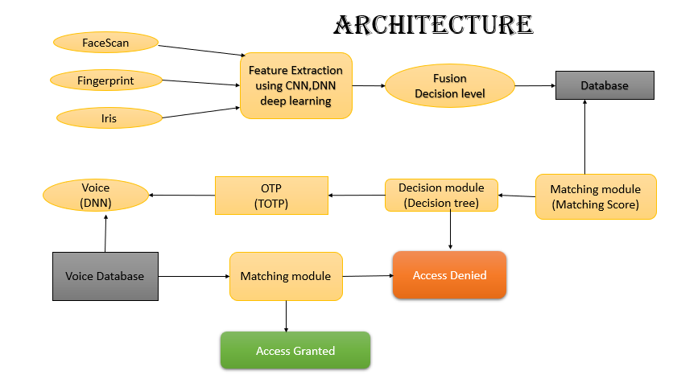
YES
NO

Slide 12
Requirements specification
HARD REQUIRMENTS :
System : Pentium 2.4 GHz.
Hard Disk : 40 GB.
RAM : 512 MB.
SOFTWARE REQUIRMENTS :
Operating system : Windows 8Professional.
Coding Language : python 3.7

Slide 13
Modules Used in Project :-
Tensorflow
Numpy
Matplotlib
Scikit-learn

Slide 14
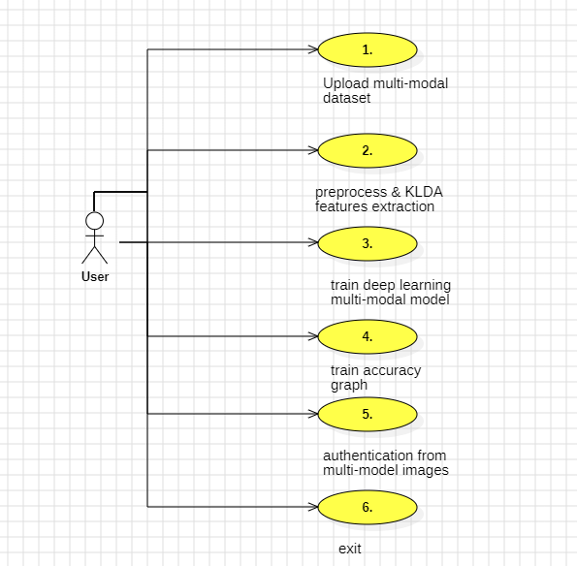
Usecase Diagram

Slide 15
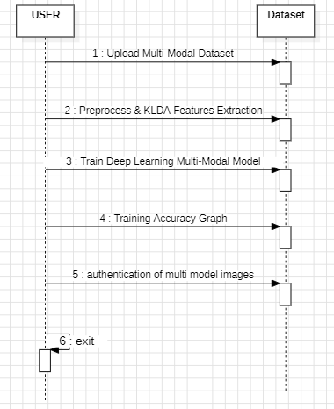
Sequence Diagram

Slide 16
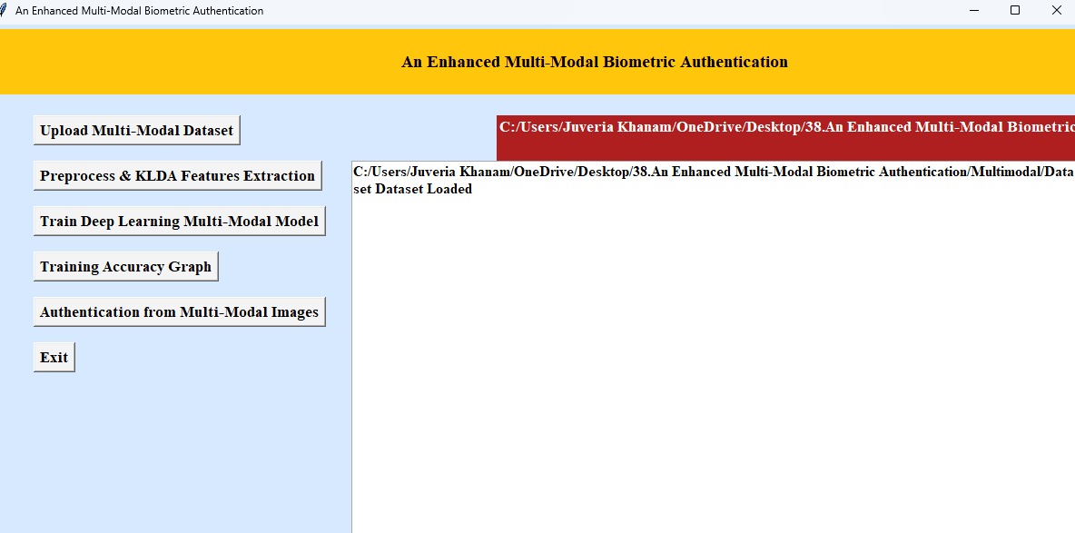
Execution:

Slide 17
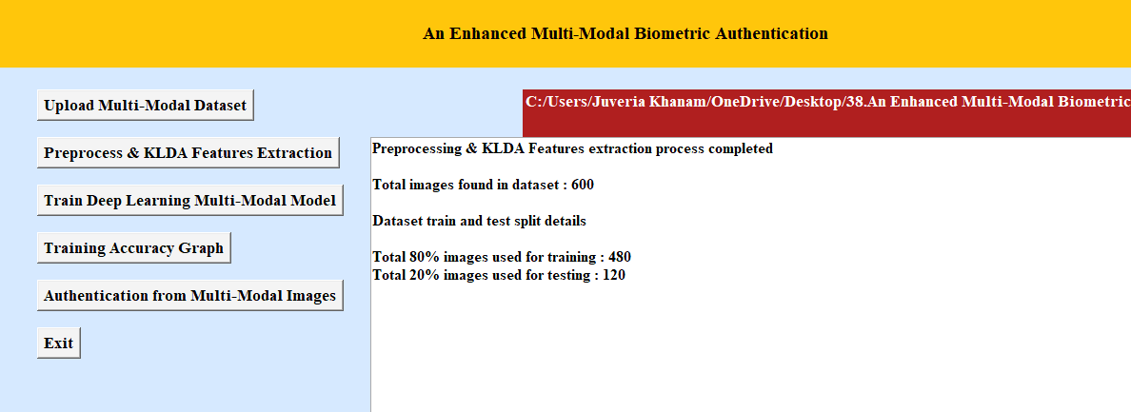
Preprocess & KLDA Feature Extraction:

Slide 18
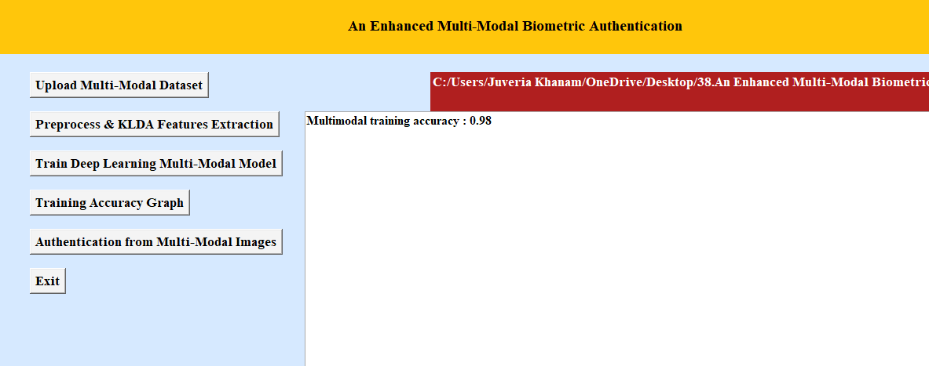
Train Deep Learning Multi-Modal Model

Slide 19
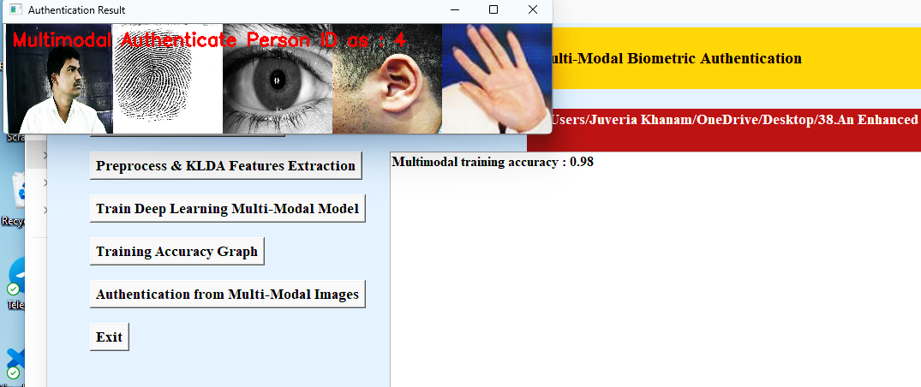
Authentication:

Slide 20
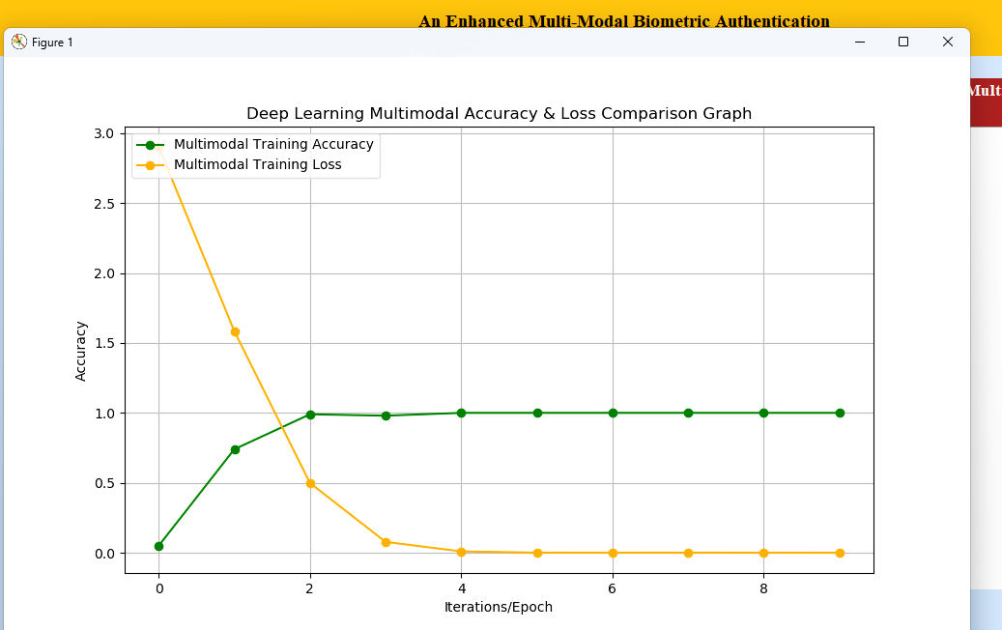
Accuracy Graph:

Slide 21

Future Scope:
Verification using several biometric modalities offers a higher level of flexibility and convenience for users by harnessing the unique advantages of multiple biometric characteristics.
Multi-modal biometric systems are more resilient to spoofing and fraudulent attempts, making them a critical tool in safeguarding sensitive information, securing access to critical infrastructure, and improving user experiences in a wide range of applications, from mobile devices and access control to financial services and government identification.

Slide 22

Conclusion:
The use of multi-modal biometric matching technologies is crucial to ensure the inclusion, high accuracy, and efficiency of national-scale identity programs, including those implementing Digital IDs.
Biometric programs, is leading the way in developing large-scale multi-modal biometric and digital ID platforms powered by face, fingerprint, and iris biometric matching technologies, and is an ideal technology provider that can be instrumental for governments and enterprises in building digital ID systems of the future that utilize multiple biometrics.

